Slide 1
The effects of COVID-19 on home values in urban vs rural areas of the US
Matthew Fay

Slide 2
Background and Stakeholders
The S&P/Case-Shiller U.S. National Home Price Index has increased by almost 20% across the last 2 years
Large domestic migrations out of cities due to fear of COVID-19 and the ability to work from home have been widely reported
How has consumer response to COVID-19 differed in US regions of high and low population density, and what effect has this had on home prices?
This analysis may provide insights for:
Homebuyers
Real estate investors
Governmental/public health organizations

Slide 3
The Data All data organized by county
Google COVID-19 Mobility Dataset
Amount of time spent in 6 different “community sectors” by Google Maps users:
Workplace
Residential
Apple COVID-19 Mobility Dataset
US Census Datasets
Population and land area
Grocery/pharmacy
Retail/recreation
Parks
Transit stations
Volume of Apple Maps requests by transportation mode:
Driving
Walking
Public transportation
Google and Apple data are daily time-series, normalized to Jan 2020, not seasonally adjusted. Data not published for pre-Jan 2020.
Zillow Home Value Indices
High, mid, and low-tier home value indices
Monthly time-series

Slide 4
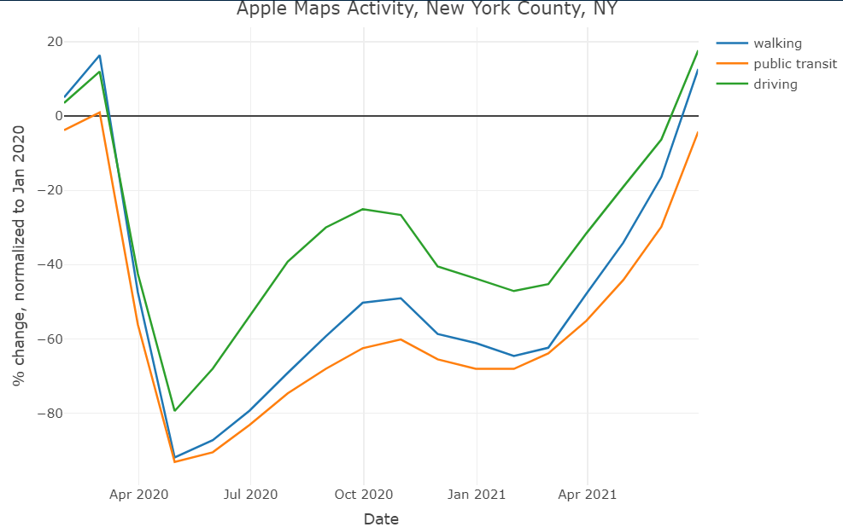
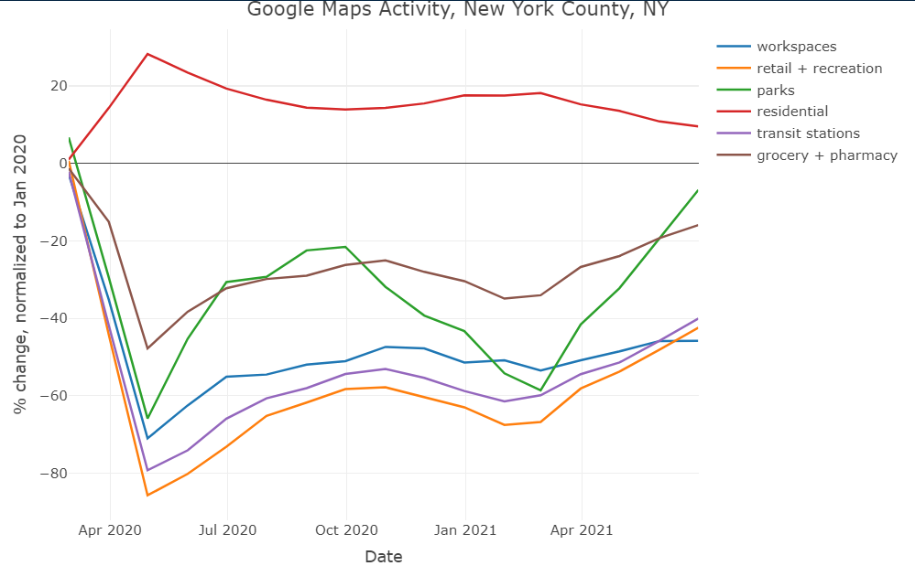
Urban areas: Activity
500+ people/square mile, as defined by US Census
Highly depressed Google Maps activity in all community sectors except residential
Highly depressed activity via all Apple Maps transportation modes until post-vaccine

Slide 5
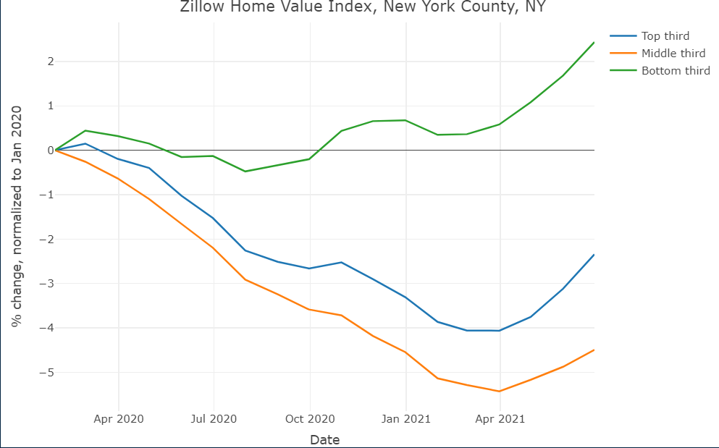
Urban areas: Home values
Small decrease to small increase in home values over the measurement period
Home values begin to rebound around the time of vaccination

Slide 6
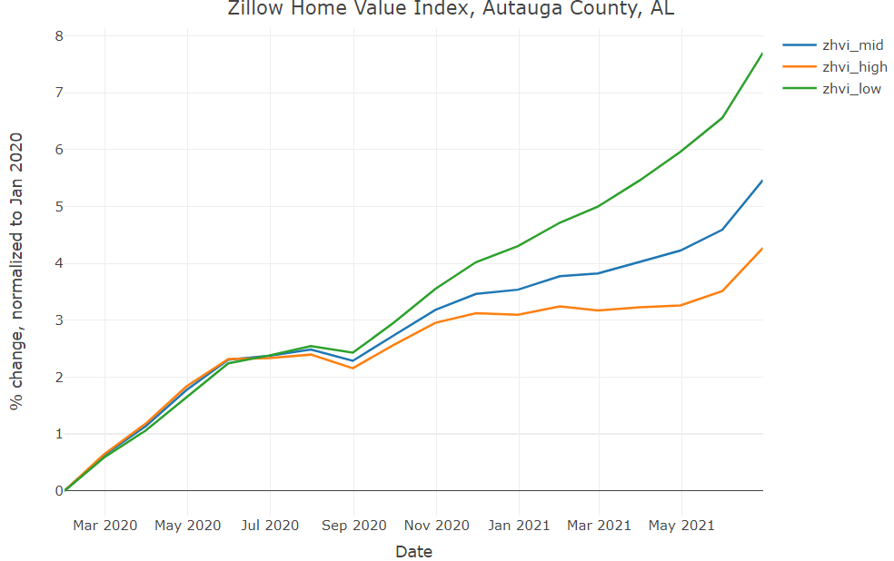
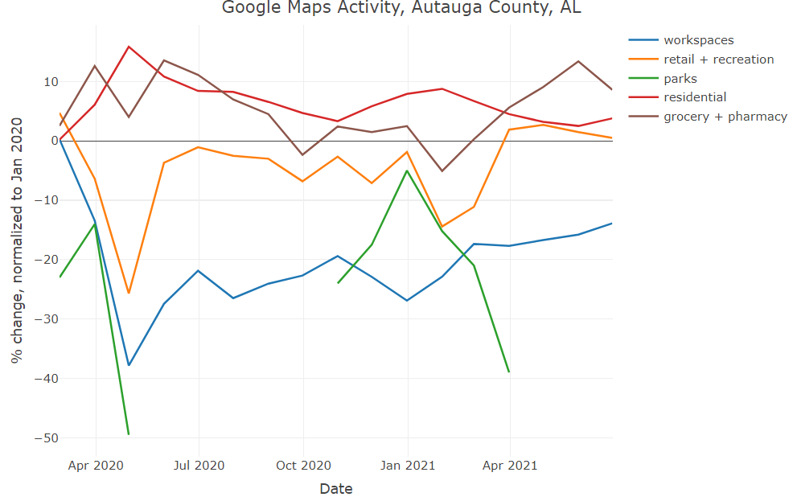
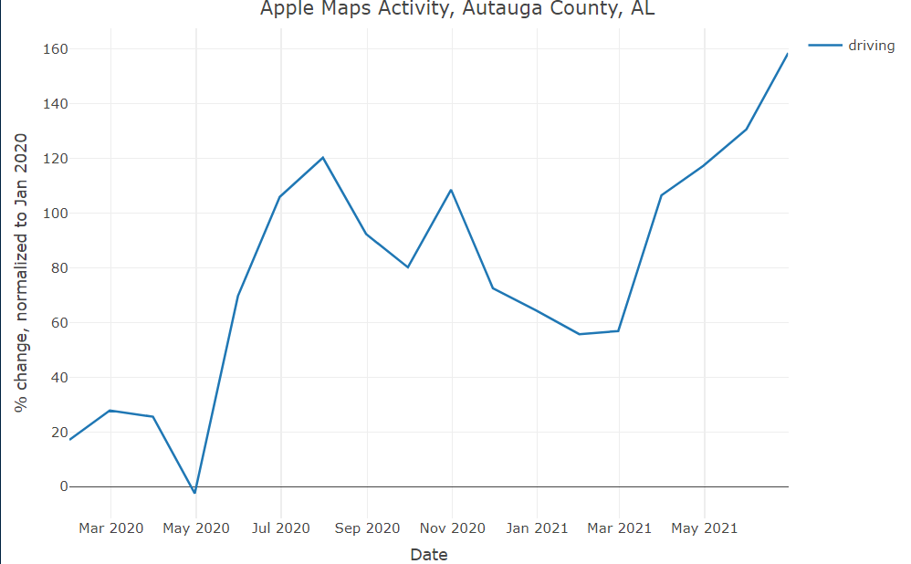
Rural areas:
<500 people/square mile, as defined by US Census
Little to no depressed activity in any community sector except work via Google Maps
Often large increases in parks
Little to no depressed driving via Apple Maps
Walking and public transport often missing datapoints or completely absent
Steady increase in home values over measurement period

Slide 7
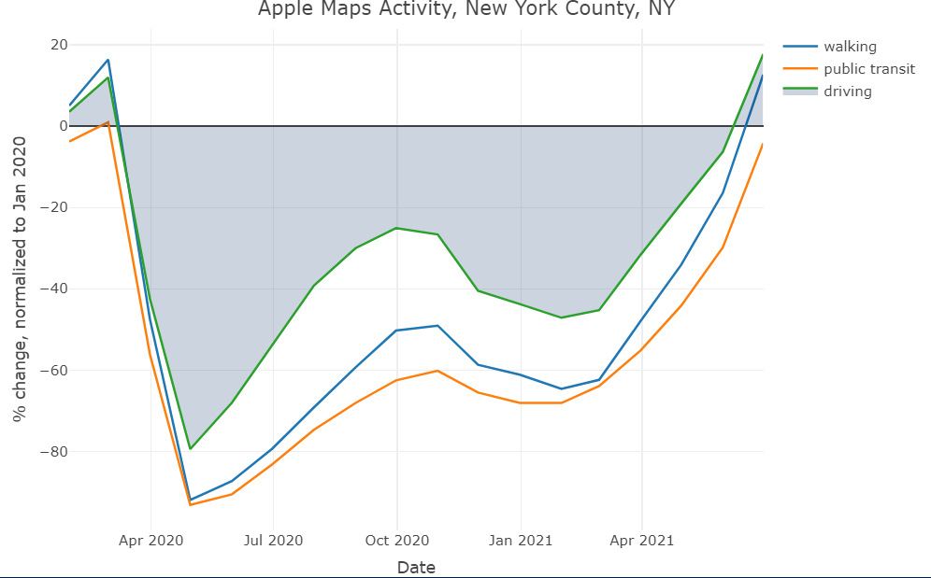
Modeling: Methodology
Data too incomplete for machine learning time-series modeling, also little experience doing that
Needed to reduce time-series data to aggregate values for the 2-year period
Integral of activity levels for different transportation methods/community sectors as recorded by Apple and Google used as “cumulative activity” metric

Slide 8
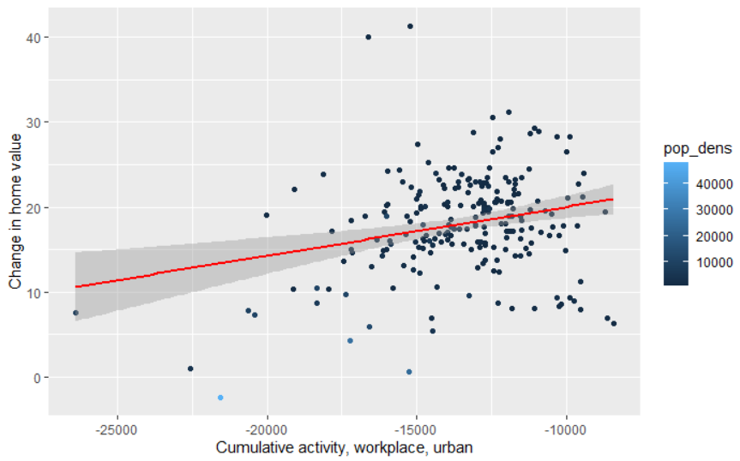
Modeling
Multiple regression not viable because too many counties missing data
Only ~150/3000 counties had all time-series data and home values
Linear models of cumulative activity vs change in home values over the measurement period
Each data point is a county, with data points weighted by population density

Slide 9
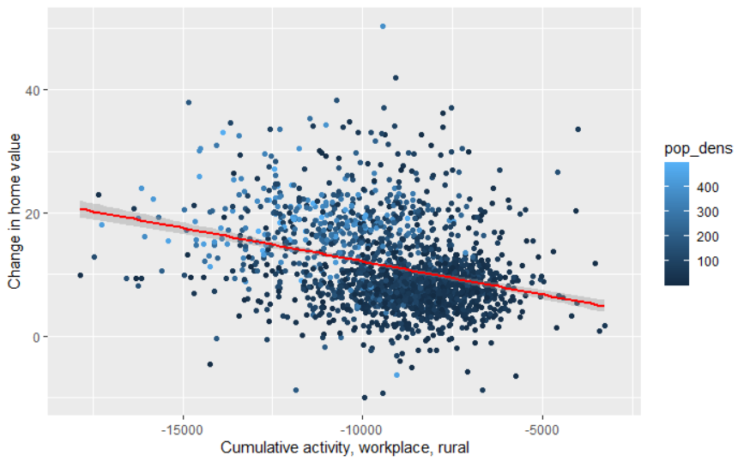
Analysis- Workplaces
Urban areas see greater increase in home value with greater workplace activity
Rural areas see greater increase in home value with less workplace activity
Within rural areas, places of lower population density have greater increase in home value

Slide 10
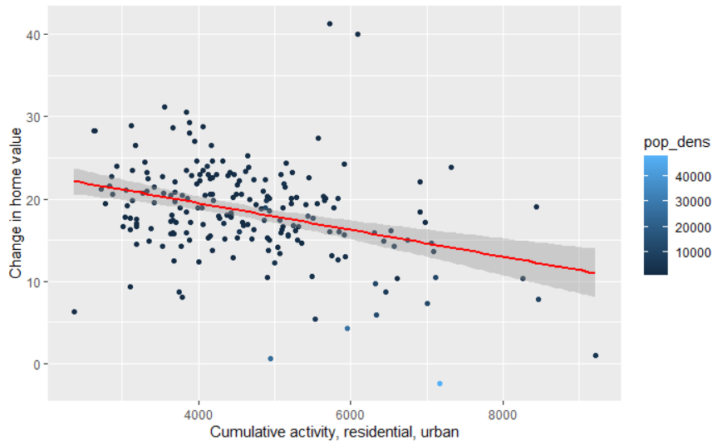
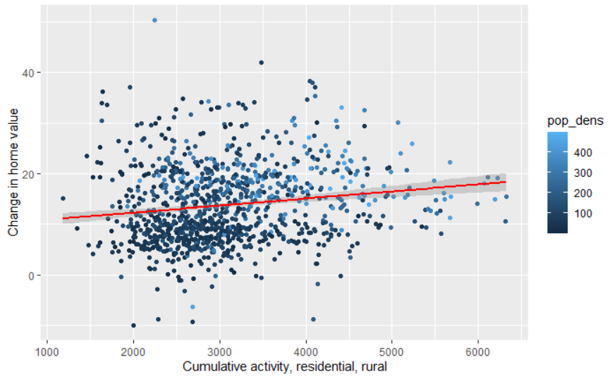
Analysis- Residential
Urban areas see lower home values with less residential activity
Rural areas see greater home values with more residential activity

Slide 11
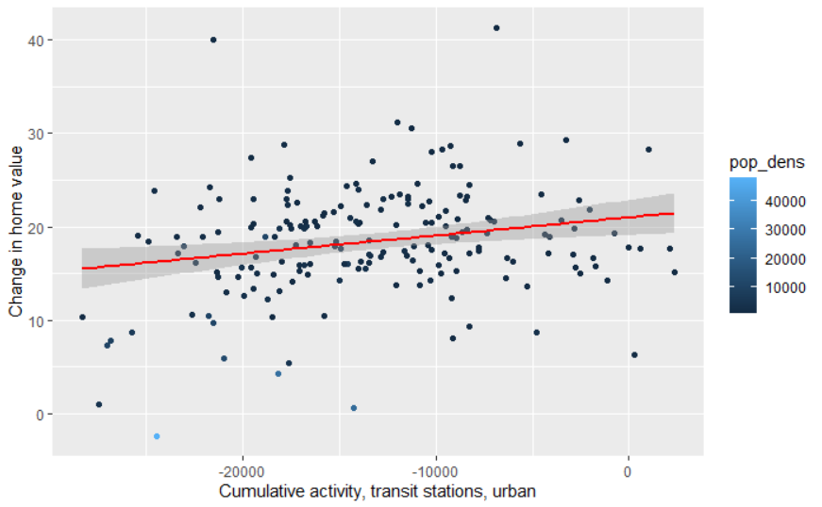
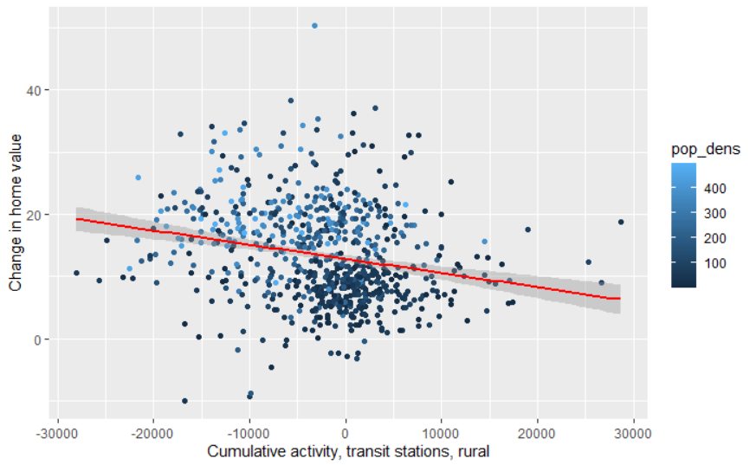
Analysis- Transit Stations
Urban areas see greater home values with more transit station activity
Rural areas see lower home values with less transit station activity

Slide 12
Conclusions
No conclusive determination whether people fleeing cities to move to rural areas has driven the recent surge in home prices
Activity shows different responses to COVID-19 in urban vs rural areas
Urban activity far more depressed than rural activity
Overall, urban areas had greater home values when they had greater work-related activity and less residential activity
Rural areas had greater home values when they had greater residential activity and less work-related activity
Possible explanations:
Rural to work-from-home boom: economic growth without going to workplace or commuting
Government-mandated business closures in urban areas: places where more people could remain working retained higher home values

Slide 13
Future directions
Shiny app where users can look at data on a map to explore geographic trends
Better cleaning and/or imputation to make the data appropriate for time-series modeling
Integration of USPS Change-of-Address Dataset for a more objective look at domestic migration

